Slide 1
Office 365 Development
July 2014

Slide 2
Course Agenda
Introduction to Office 365 Development
Module 1: Deep Dive Apps for Office in Outlook
Module 2: Deep Dive Apps for Office in Word
Module 3: Deep Dive Apps for Office in PowerPoint
Module 4: Deep Dive Apps for Office in Excel
Module 5: Deep Dive into SharePoint Hosted Apps
Module 6: Deep Dive into Provider Hosted Apps
Module 7: Deep Dive into Security and OAuth
Module 8: App Lifecycle Management

Slide 3
App Lifecycle Management
Speaker
Speaker

Slide 4

Agenda
Overview
Visual Studio Online
Microsoft Test Manager

Slide 5
Overview

Slide 6
What is ALM?
ALM stands for Application Lifecycle Management
Key tenets:
A continuous process of managing the lifecycle of an application through governance, development, and maintenance
Integrating different teams, platforms, and activities
Enabled through a set of tools and processes
Visual Studio, Scrum

Slide 7
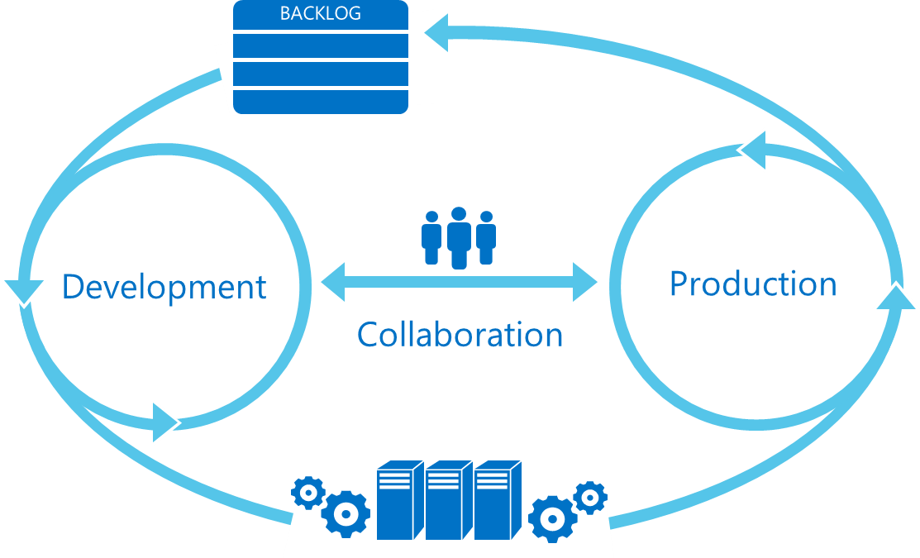
Lifecycle Overview
Plan
Monitor + Learn
Develop + Test
Release

Slide 8
Key Components
Visual Studio Online
Microsoft Test Manager

Slide 9
demo
Provider-Hosted App Source Control

Slide 10
Visual Studio Online

Slide 11











Visual Studio 2013 ALM
Source Repos
Agile Planning
Team Rooms
Test Case Management
Feedback Management
Build and Continuous Integration
Team Foundation Server
Visual Studio Online

Slide 12

Capabilities and Features
Plan
Operate
REQUIREMENTS
Agile portfolio management
BACKLOG
Visual Studio and System Center integration
Kanban customization
Work item tagging
Work item charting
Performance events
Build | Measure | Learn
Collaborate
Construct
Operate
Develop
Release
Team Room
Integrated release management
Git
RELEASE
CodeLens
Configuration-based deployments
.NET memory dump analyzer
Load testing as a service
WORKING SOFTWARE

Slide 13
O365 ALM
Development Environment with Teams
Used to require separate VMs, VM-capable hardware
O365 development sites (per developer) regardless of on-prem or O365 deployment
SharePoint on-prem developer sites (per developer)
What to do with Napa in a team environment
Build Processes
Non-compiled code needs build too (Continuous Integration)
Build, deployment, and testing still done by TFS with some help
Yes, you still have to “Trust It”, but…
Coded UI Build Verification Tests (BVTs) still validate the build

Slide 14
Solution Deployment

Slide 15
Solution Deployment – Provider Hosted

Slide 16
Work Item Tracking
Track work by category
Works with familiar tools
Visual Studio
Excel
Project
Customizable based on your individual needs
Fields, workflows, states customizable through process editor

Slide 17
Version Control
Use Team Foundation Version Control or Git
Integration with Work Items and Team Foundation Build – enables traceability back and forth.
Web Portal enables access to basic version control features.

Slide 18
Build Automation
Build Automation
Continuous Integration (CI)
Tightly coupled with other TFS components:
Version control
Work item tracking
Testing tools
Deployment
Lab management
Build code using Git
Propagates build results to data warehouse for historical reporting

Slide 19
Reporting
Built on SSRS and SSAS
Can customize existing reports or create custom reports
Available via SQL Server Reporting Services, Excel Reports, SharePoint dashboards, or Work Item Queries

Slide 20
demo
Continuous Integration

Slide 21
Microsoft Test Manager

Slide 22
O365 Testing Considerations
Tenants can be different versions
APIs between versions will be subject to roll out schedules
Testing environment should be in the same tenant as “production”
Regression testing should cover SharePoint to provider-hosted components
Coded UI Testing vs. Non Coded UI Testing

Slide 23
Testing

Slide 24
Testing

Slide 25
demo
Build Verification Testing

Slide 26
Summary
Overview
Visual Studio Online
Microsoft Test Manager

Slide 27

© 2012 Microsoft Corporation. All rights reserved. Microsoft, Windows, and other product names are or may be registered trademarks and/or trademarks in the U.S. and/or other countries.
The information herein is for informational purposes only and represents the current view of Microsoft Corporation as of the date of this presentation. Because Microsoft must respond to changing market conditions, it should not be interpreted to be a commitment on the part of Microsoft, and Microsoft cannot guarantee the accuracy of any information provided after the date of this presentation. MICROSOFT MAKES NO WARRANTIES, EXPRESS, IMPLIED OR STATUTORY, AS TO THE INFORMATION IN THIS PRESENTATION.

